Slide 2
High Periconception PrEP Uptake and Adherence Among Women in South Africa
Lynn T. Matthews
University of Alabama at Birmingham (UAB) * Division of Infectious Disease
Manjeetha Jaggernath, Yolandie Kriel, Christina Psaros, Kasey O’Neil, Patricia Smith, Kara Bennett,
Craig Hendrix, Jessica E. Haberer, Jared M. Baeten, Kathleen Wirth, David R. Bangsberg, Jennifer A. Smit
@ltmatthews
Share your thoughts on this presentation with #IAS2019

Slide 3

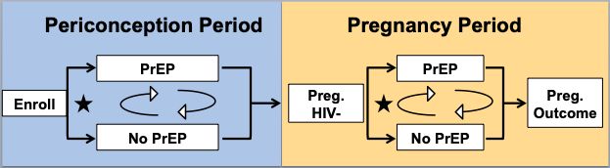
Background
Methods, 1
High HIV incidence among women of reproductive age (4.4/100WY, #LBPE-C23).
Many HIV-exposed women and/or their partners want to have children.
Women who conceive while exposed to HIV need strategies to mitigate HIV acquisition risks: Safer Conception.
PrEP is an effective safer conception strategy.
ZINK is a longitudinal study to evaluate use of TDF/FTC as PrEP among 350 HIV-exposed women planning for pregnancy in Durban, South Africa.
Hypotheses: 70% periconception PrEP uptake. 80% of women will adhere to >80% of PrEP doses.
Eligibility
HIV-uninfected women
18-35 years old
Personal or partner pregnancy desire in the next year
Partner is living with HIV or unknown serostatus
Study follow-up
Periconception Period
Pregnancy Period
PrEP
PrEP
Preg.
HIV-
Preg.
Outcome
Enroll
No PrEP
No PrEP

Slide 4

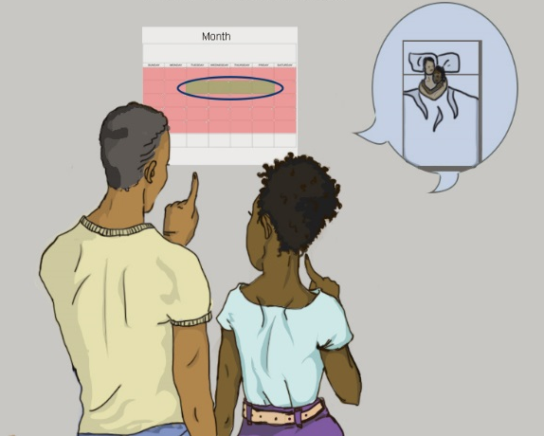
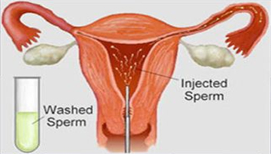
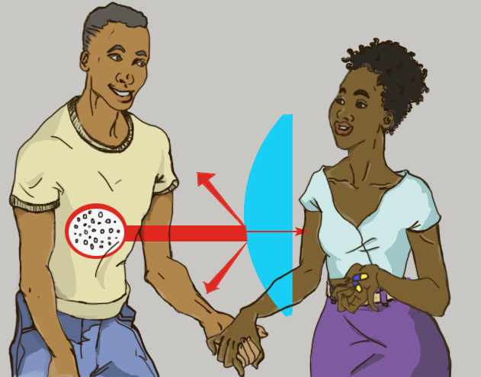
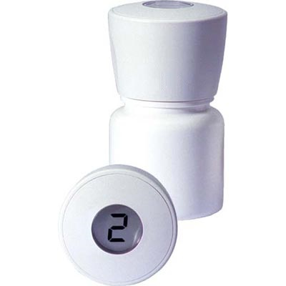
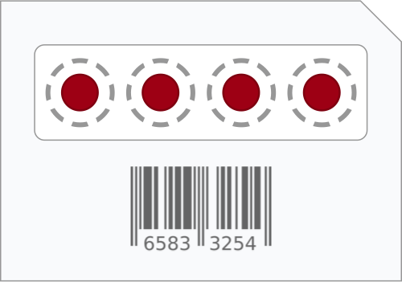
Methods, 2
Quarterly safer conception counseling content
Partner communication, couples-based HCT
ART
PrEP
Sex at peak fertility
Sperm washing
Outcomes
PrEP uptake
Adherence
by electronic pill cap
Drug levels

Slide 5
Results
Participant characteristics, 207 women
Variable | N (%), Med. (Min, Max)
Age | 24 (18, 35)
Completed high school | 84%
Not employed | 68%
Prior pregnancy | 128 (62%)
Partner HIV-serostatus unknown | 196 (97%)
Initiate PrEP (N=203) | 130 (64%)
Periconception PrEP Adherence
MEMS
TFV plasma
%
of women
At least 80% of doses taken
N=49
Plasma TFV @ 3M
N=40

Slide 6
Results
Participant characteristics, 207 women
Variable | N (%), Med. (Min, Max)
Age | 24 (18, 35)
Completed high school | 84%
Not employed | 68%
Prior pregnancy | 128 (62%)
Partner HIV-serostatus unknown | 196 (97%)
Initiate PrEP (N=203) | 130 (64%)
Periconception PrEP Adherence
MEMS
TFV plasma
%
of women
At least 80% of doses taken
N=49
Plasma TFV @ 3M
N=40

Slide 7
Results
Participant characteristics, 207 women
Variable | N (%), Med. (Min, Max)
Age | 24 (18, 35)
Completed high school | 84%
Not employed | 68%
Prior pregnancy | 128 (62%)
Partner HIV-serostatus unknown | 196 (97%)
Initiate PrEP (N=203) | 130 (64%)
Periconception PrEP Adherence
MEMS
TFV plasma
%
of women
At least 80% of doses taken
N=49
Plasma TFV @ 3M
N=40

Slide 8
Results
Participant characteristics, 207 women
Variable | N (%), Med. (Min, Max)
Age | 24 (18, 35)
Completed high school | 84%
Not employed | 68%
Prior pregnancy | 128 (62%)
Partner HIV-serostatus unknown | 196 (97%)
Initiate PrEP (N=203) | 130 (64%)
Periconception PrEP Adherence
MEMS
TFV plasma
%
of women
At least 80% of doses taken
N=49
Plasma TFV @ 3M
N=40

Slide 9

Conclusions
Thank you
There is demand for safer conception care delivered to individuals.
PrEP uptake is high among HIV-exposed women planning for pregnancy.
Nearly half have detectable drug in the first 12 weeks.
Many women are not able to achieve sufficient periconception adherence to confer protection.
Ongoing mixed-methods analysis of prevention-effective adherence will inform interventions to support safer conception for women.
ZINK Team
ZINK participants
R01-MH108412
Gilead Sciences
@ltmatthews

